Slide 1
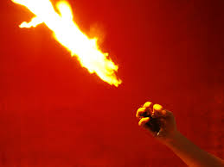
Cornstarch Fireball Lab

Slide 2
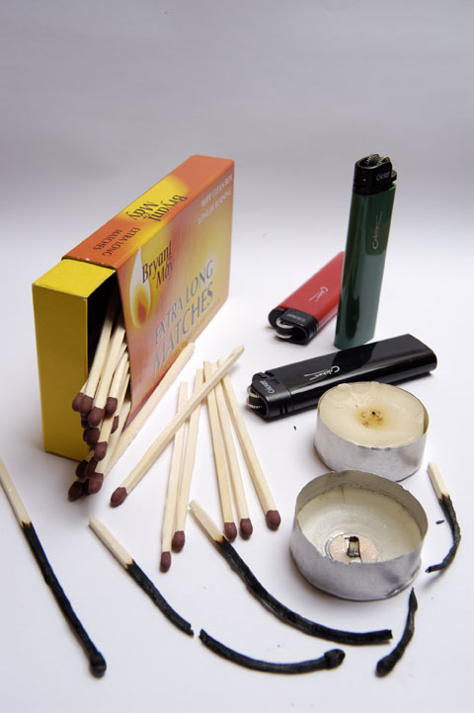
Oxygen =
in the air
Fire
triangle
Heat =
matches and lighters
Fuel =
Candle wax, wick and wood of the match

Slide 3
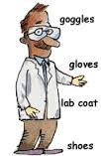
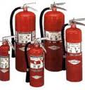
Lab Safety Before You Begin
Read the instructions
Organize the lab (make sure to have fire blanket and/or fire extinguisher).
Wear goggles and
protect your skin.

Slide 4
Lab Safety During the Lab
Don’t play around (no comedy routines)
Practice good fire safety skills
Handle chemicals properly
Follow instructions

Slide 5
Lab Safety After the Lab
Clean up all messes
Dispose of materials properly
Put lab supplies back where they belong

Slide 6
Actions Steps for Fire Safety

Slide 7
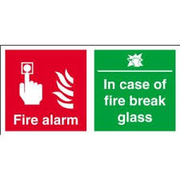
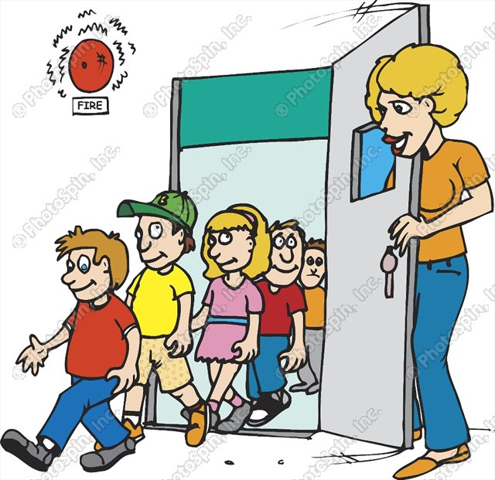
Fire Alarm Procedures
Stop immediately what you are doing.
Line up quietly.
Look to your teacher for
directions for exiting the
building.
Exit the building to the front lawn.
Wait quietly for further instructions.

Slide 8
Burn Injuries
1st Degree
2nd Degree
3rd Degree

